Slide 1
Full Stack CICD of Kubernetes Microservices using DevOps and IaC
Isaac Johnson @Medtronic

Slide 2
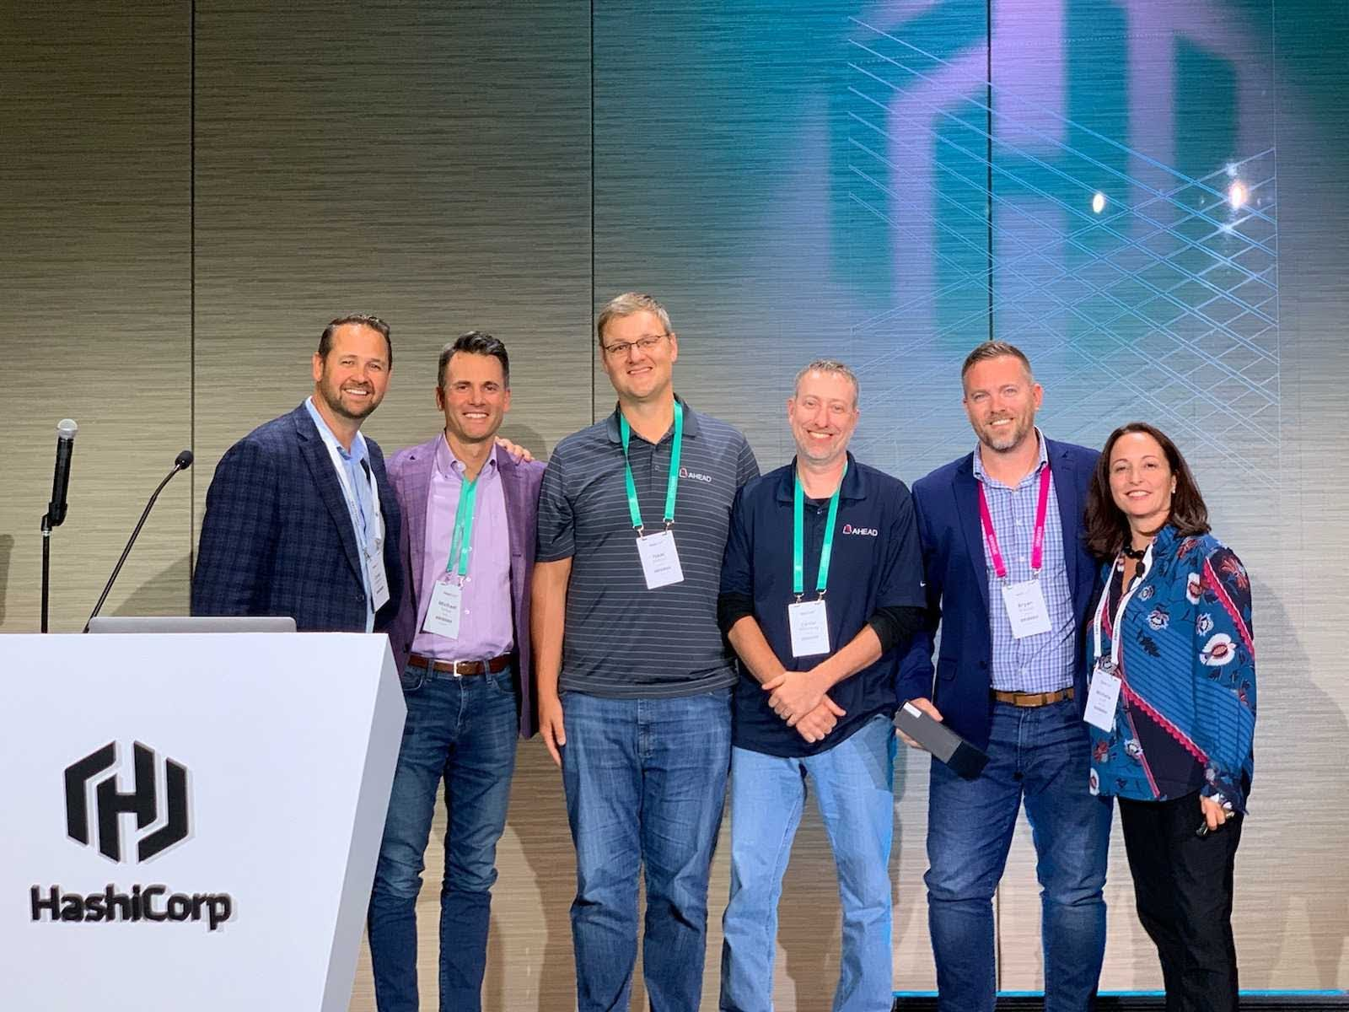
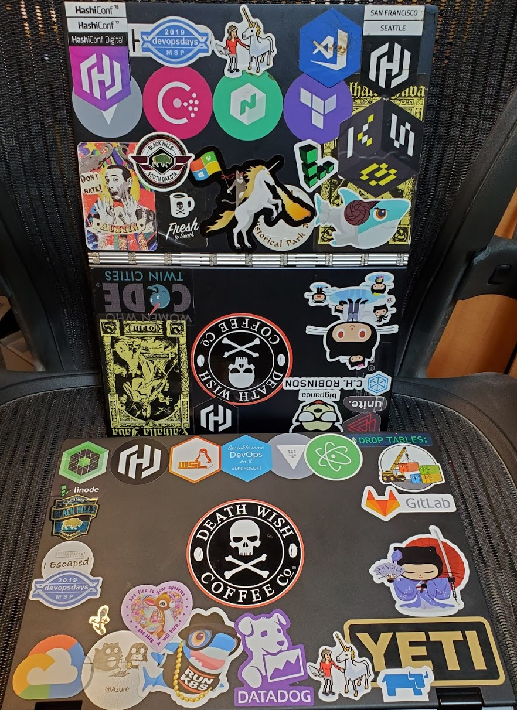
About Me
Originally from Minnesota
San Diego 2010-2017.
Family guy who really misses movies at the Alamo Drafthouse
Enjoys camping, fishing and being outdoors
Death Wish Coffee and insanely spicy foods
In free time, creates courses for WhizLabs on DevOps
Started Career at Control Data
Principal SW Engineer at Medtronic
however, I’m Cloud Solutions Architect at heart

Slide 3
Disclaimer
The views and opinions expressed in this Open Source North talk are those of the authors (Isaac Johnson) and do not necessarily reflect the official policy or position of his employer, family, friends, denomination, country, place of origin, government, or pretty much anyone else. Any content provided by Isaac Johnson are of his opinion and are not intended to malign any religion, ethnic group, club, organization, company, individual or anyone or anything. These opinions are not that of Medtronic. In fact, chances are they are well intentioned but likely flawed in some fashion by years of high test coffee consumption and EDM piped through headphones at ridiculous decibels.

Slide 4
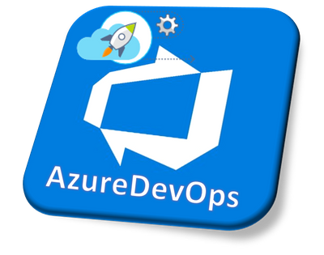
Problem Statement
We need to create a full containerized microservice platform using Kubernetes.
We need to use Azure DevOps but prefer to leverage Open Source solutions.
We need to document all that we do (so that we may scale)
We want corn fields, not flower boxes (for my Vegan friends)
We will make mistakes: We want to fail fast and alert quickly.
We want to leverage PaaS and SaaS.
Desires Requirements

Slide 5
Proposed Solution
Azure DevOps YAML Pipelines.
We should treat our build layer with the same review and policy rigor as our running code.
Azure VMSS Agent pools and Azure Pipeline Pools
No special build agents that have been hand altered
Azure Key Vault for Secrets
Leverage via YAML tasks and “Library” for classic pipelines
Azure Kubernetes Service with AAD RBAC
Integrate with existing ID Provider
ACR for Container and Helm storage
Hashi Terraform for IaC layer

Slide 6
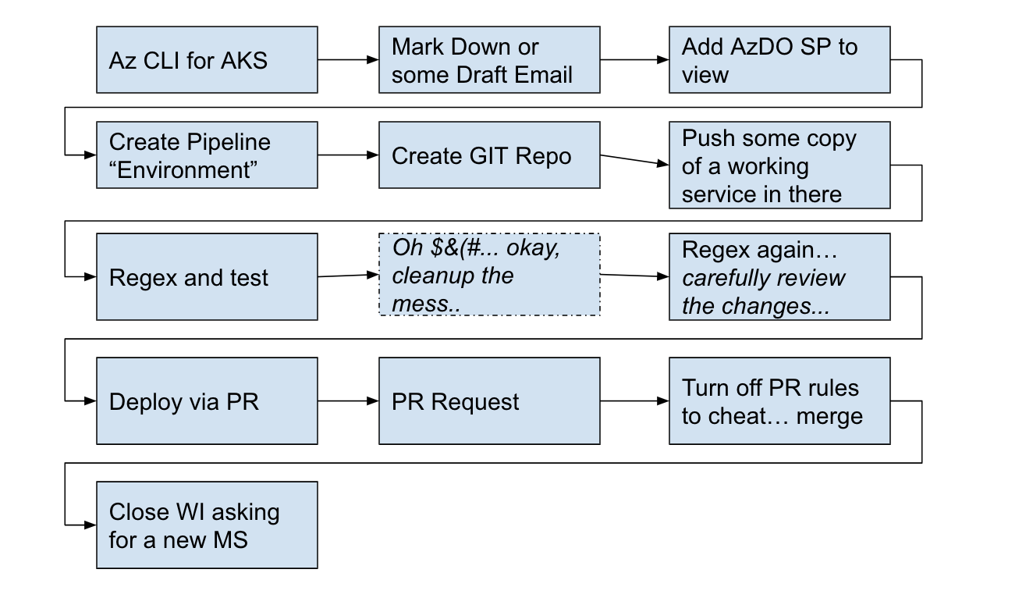
In the beginning...

Slide 7
When Automations Fall Down...
customer
Mistakes…
customer
Mistakes…
customer
Mistakes…
Queue for 1..n
Queue for 1..n
automation
Pipelines running: 1 10 20
10 100 2000

Slide 8
Rethinking things
Semaphore: variable or abstract data type used to control access to a common resource by multiple processes and avoid critical section problems in a concurrent system such as a multitasking operating system
Semaphore
Automation
Templates
Unique
logic
Some WI Driven Automations
Templates: define reusable content, logic, and parameters. Templates function in two ways. You can insert reusable content with a template or you can use a template to control what is allowed in a pipeline
Onboard Users
New Microservice (Repo)
New Sonar Key
WI Query
New YAML Pipeline Onboarding
WI Query
WI Query
WI Query

Slide 9
Semaphore
https://dev.azure.com/OURORG/OurProject/_apps/hub/ms.vss-build-web.ci-designer-hub?pipelineId=1234&branch=wia-processusers
- task: AzureCLI@2
displayName: 'Azure CLI - wiq OnboardingsToProcess'
inputs:
azureSubscription: 'DevOps Environment (f492bf32-ca57-4f93-97a2-8c7bc99ffd48)'
scriptType: bash
scriptLocation: inlineScript
inlineScript: 'az boards query --organization https://dev.azure.com/OURORG/ --id $(myWIQuerID) -o json | jq ''.[] | .id'' | tr ''\n'' '','' > ids.txt'
env:
AZURE_DEVOPS_EXT_PAT: $(DevOpsPAT)
- task: AzureCLI@2
displayName: 'Azure CLI - Pipeline Semaphore'
inputs:
azureSubscription: 'Azure Environment (asdf-asdf-asdf-asdf-asdf)'
scriptType: bash
scriptLocation: inlineScript
inlineScript: 'az pipelines build list --project OurProject --definition-ids 1234 --org https://dev.azure.com/OURORG/ -o table > $(Build.StagingDirectory)/pipelinestate.txt'
env:
AZURE_DEVOPS_EXT_PAT: $(DevOpsPAT)
A WI Query into just a string of CSV
Check the states of running instances of this pipeline

Slide 10
Setting up CSV/IDs
Take IDs from our WI Query as a CSV and make an AzDO Var
- bash: |
#!/bin/bash
set +x
# take comma sep list and set a var (remove trailing comma if there)
echo "##vso[task.setvariable variable=WISTOPROCESS]"`cat ids.txt | sed 's/,$//'` > t.o
set -x
cat t.o
displayName: 'Set WISTOPROCESS'
- bash: |
set +x
export IFS=","
read -a strarr <<< "$(WISTOPROCESS)"
# Print each value of the array by using the loop
export tval="{"
for val in "${strarr[@]}";
do
export tval="${tval}'process$val':{'wi':'$val'}, "
done
Turn a CSV string into JSON block: processXX{wi:XX}

Slide 11
Using Semaphore
if [[ "$(WISTOPROCESS)" == "" ]]; then
echo "##vso[task.setvariable variable=mywis;isOutput=true]{}" > ./t.o
else
echo "##vso[task.setvariable variable=mywis;isOutput=true]$tval" | sed 's/..$/}/' > ./t.o
fi
# regardless of above, if we detect another queued "notStarted" or "inProgress" job, just die.. don't double process
# this way if an existing job is taking a while, we just bail out on subsequent builds (gracefully)
export tVarNS="`cat $(Build.StagingDirectory)/pipelinestate.txt | grep -v $(Build.BuildID) | grep notStarted | head -n1 | tr -d '\n'`"
export tVarIP="`cat $(Build.StagingDirectory)/pipelinestate.txt | grep -v $(Build.BuildID) | grep inProgress | head -n1 | tr -d '\n'`"
if [[ "$tVarNS" == "" ]]; then
echo "No one else is NotStarted"
else
echo "##vso[task.setvariable variable=mywis;isOutput=true]{}" > ./t.o
fi
if [[ "$tVarIP" == "" ]]; then
echo "No one else is InProgress"
else
echo "##vso[task.setvariable variable=mywis;isOutput=true]{}" > ./t.o
fi
set -x
cat ./t.o
Null JSON on empty set
Matrix on JSON (0..n)
Any other running or queued pipeline, then empty this one (make it a no-op)
- job: runner
dependsOn: parse_work_item
strategy:
matrix: $[ dependencies.parse_work_item.outputs['mtrx.mywis']]

Slide 12
A typical IaC Repo
OurProjectAKS
configure/
istio/
010-cluster-roles.yaml
020-companyspecific.yaml
030-azdoagents.yaml
040-aad-groups.yaml
050-nginx-ingress.yaml
docs/
SETUP.md
pubs/
RequestAccess.md
apiVersion: rbac.authorization.k8s.io/v1
kind: ClusterRoleBinding
metadata:
name: company-cluster-admins
roleRef:
apiGroup: rbac.authorization.k8s.io
kind: ClusterRole
name: company-team-cluster-admin
subjects:
- apiGroup: rbac.authorization.k8s.io
kind: Group
# DL SomeTeam : dl.someteam@company.com
name: "asdfasdf-asdf-asdf-asdf-asdfasdfasdf"
examples/
my-cluster-admin.yaml
terraform/
main.tf
output.tf
variables.tf
README.md
azure-pipelines.yaml

Slide 13
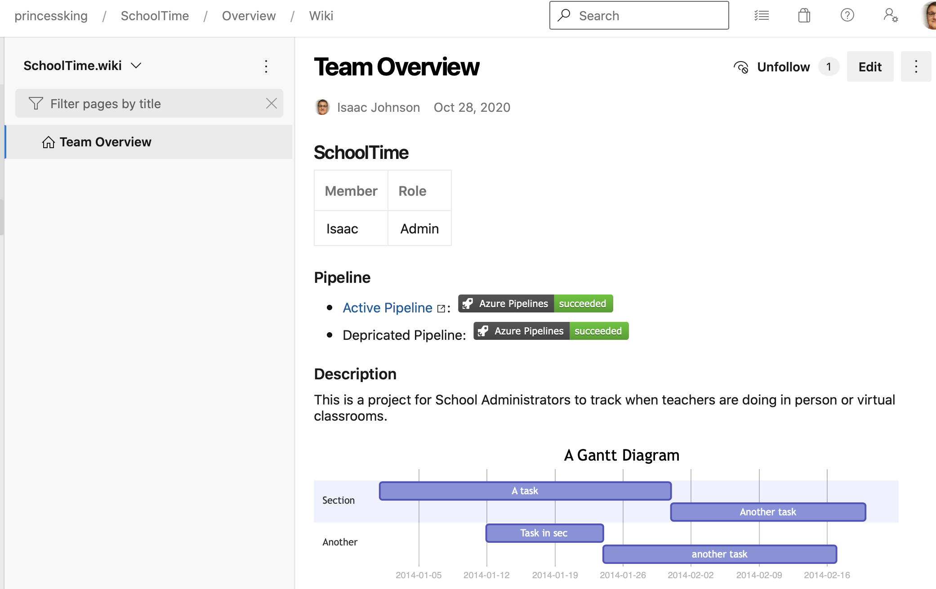
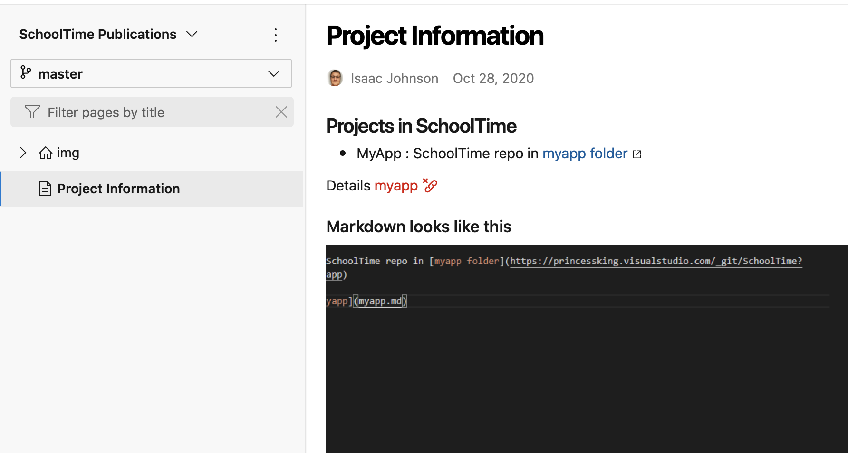
Documentation vs Publications
Docs:
Runbooks
How-to’s
Legacy one-offs
Notes on Infra setup
Team Meetings
Pubs:
How-to’s for users
FAQs
REST Docs
More information
Status/Dashboards

Slide 14
AKS ACR Process
Terraform
plan
apply
configure
destroy
AKS
Priv IAM steps
Networking
Manual gate
Primary ACR
ACR
New SP
Configure
AzureRM
Storage
Save Settings to AKV

Slide 15
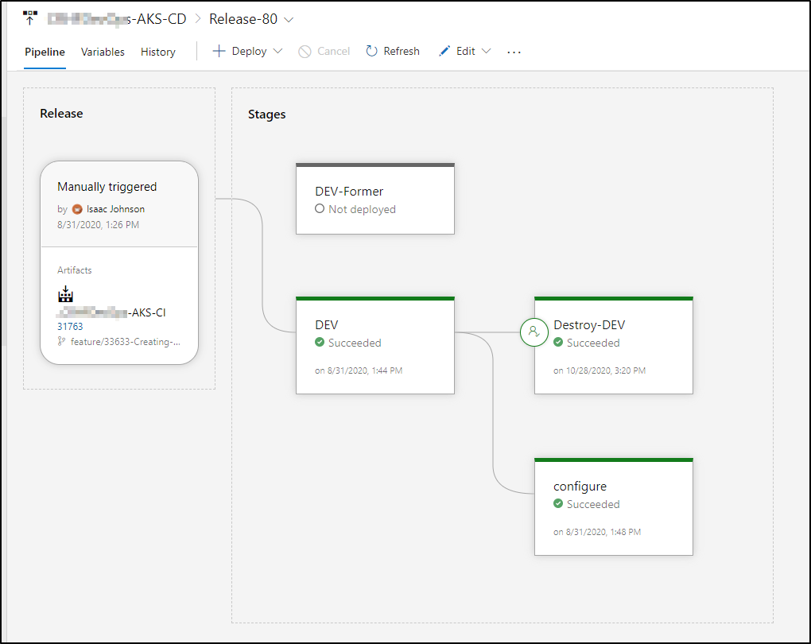
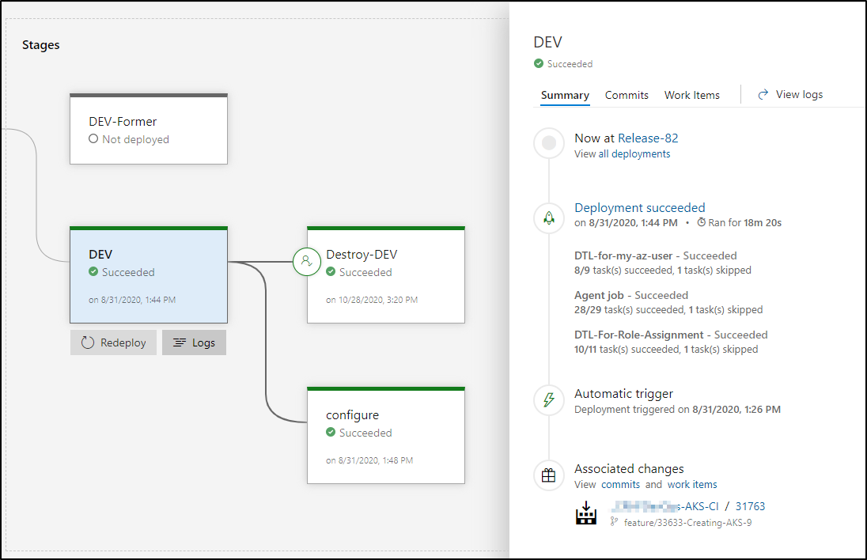
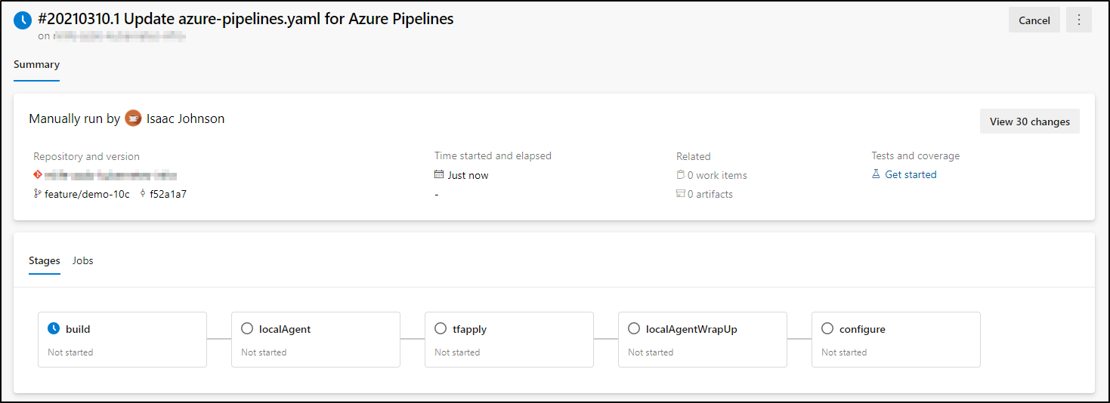
AKS ACR Process

Slide 16
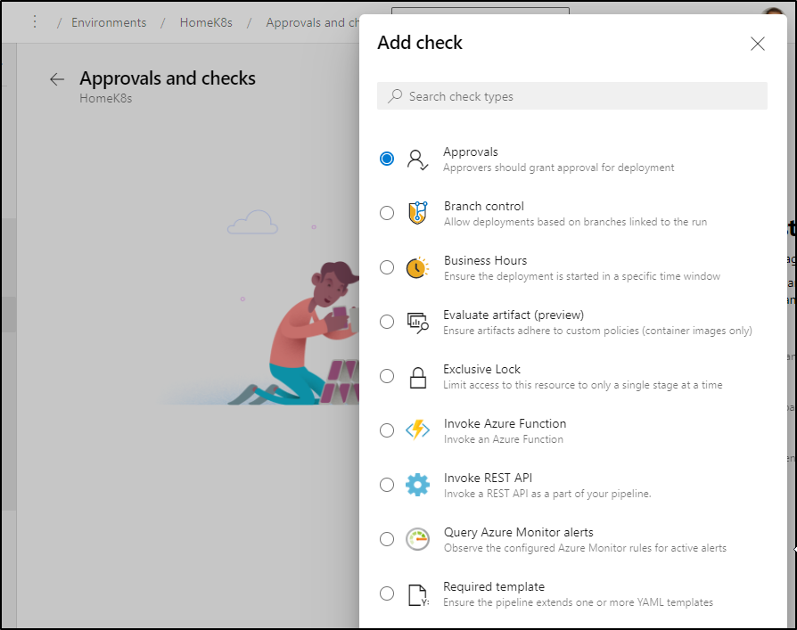
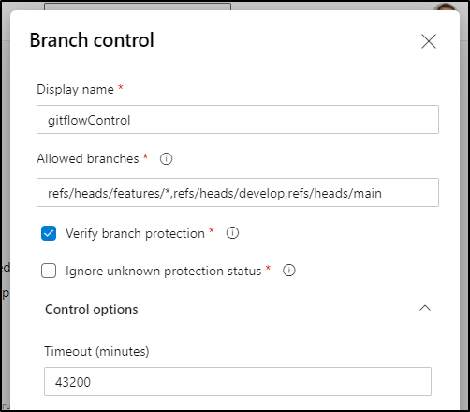
AKS ACR Process
K8s ACR
AKV
AKS
ns
Dev Infra
SP
Environment
Azure Service Connection
template
MS
MS

Slide 17
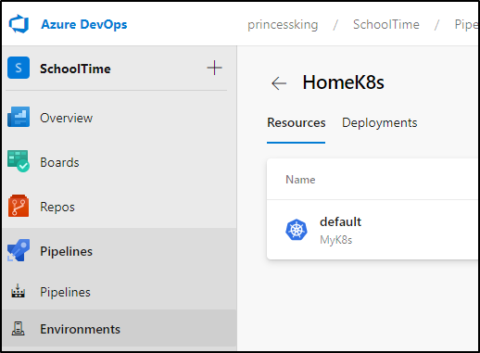
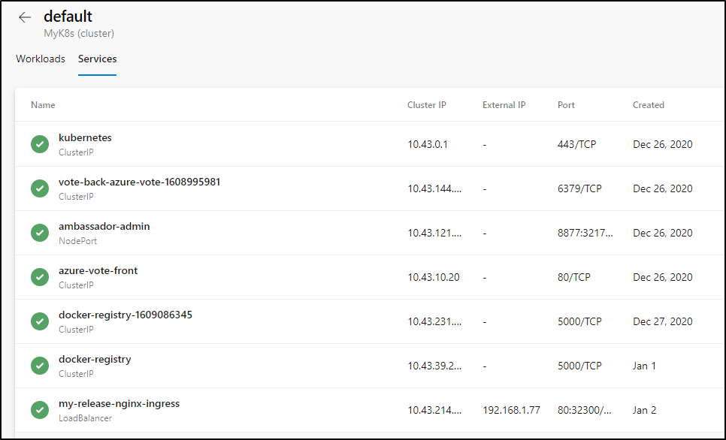
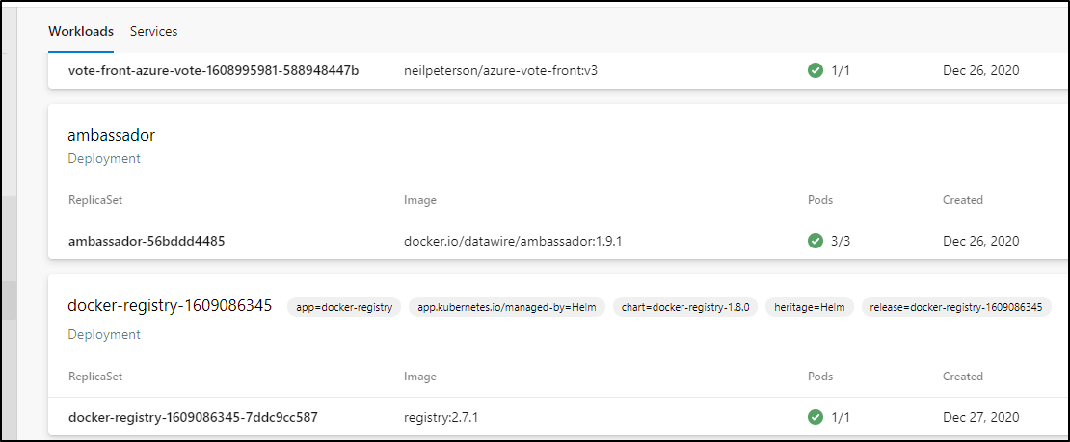
Environment vs Service Connections
Expose just 1 namespace at a time
Created interactively
Require exposed management plane
Easy to view Workloads and Services, including those outside AzDO deploys
Developers need only to refer to environment (no need to know KV or access keys)

Slide 18
Considerations
Kubernetes is not static: Be it EKS, GKE or AKS, “supported versions” in a region or zone keep changing - expect to have to upgrade.
Consider IP Subnets when using Azure CNI or non-kubenet networking (every pod, node, etc takes an IP).
If you’ve exhausted your range, you may have to create a new Node Pool in a different subnet manually
AKS with AAD uses your Access Token Lifetime from the Identity Platform
You may not be able to change the default 1 hour timeout
Notes:
Consider the impact of Sidecars on Cron Jobs
The non-persistent cron may close, but the sidecar remains
https://docs.microsoft.com/en-us/azure/active-directory/develop/active-directory-configurable-token-lifetimes

Slide 19
Microservice Patterns
Requirements
Migration to YAML
Patterns
Process Overview
Scaling to multi-cloud
Scaling Microservices

Slide 20
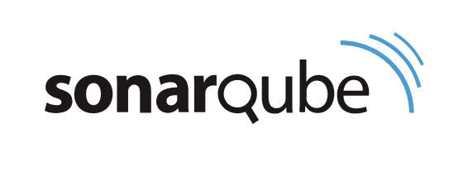
Requirements
Support Java and Dotnet microservices
Might have different versions of java and .NET
Auto generate .NET and Java client bindings from Swagger (swagger gen)
Deploy using YAML and/or Helm
Use patterns for Sonar exclusions, Unit Tests

Slide 21
Phased Migration (Classic To YAML)
Task Groups
Build
Release
ClassicUI / AKS
Task Groups
Libraries for AKV
Build Pipelines created Pipeline Artifacts (drop.zip) handed off to Release Pipelines
Release Pipelines Gates on Branches
Leveraged Kubernetes Tasks with AKV
YAML / Environments
Multi-Stage YAML
leveraged Templates from controlled project
Yaml/Helm to “Environment” which could be gated on branch
Secrets directly with AKV task
YAML templates for WI Automation for onboarding
AzureRM
Library
AKV
AKS
ns
environment
YAML
Templates

Slide 22
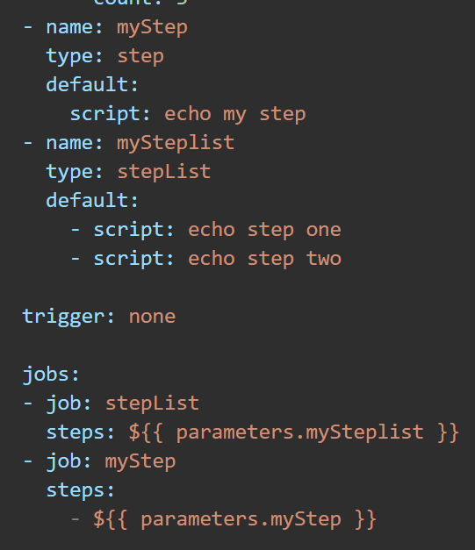
Task Groups vs YAML Templates (Classic to YAML)
Task Groups
One version, but with history
Task Group permissions for all task groups
Cannot control parameters (auto detected)
Can set default and description
Project Bound
Visual Editor
Right click to create (easy)
YAML Templates
Multiple Branches, history
PR policies and easy to contribute
Can control parameters and defaults
Extends
Conditional Logic
Can be used for stage, job, steps, etc
Pull from any git provider and local
No visual editor*
Notes:
https://docs.microsoft.com/en-us/azure/devops/pipelines/process/templates?view=azure-devops

Slide 23
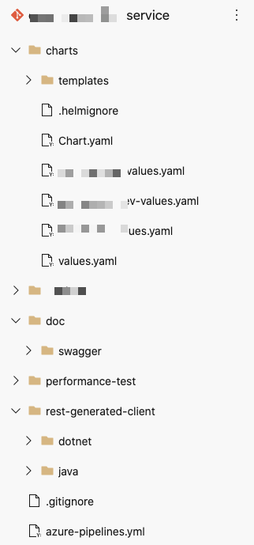
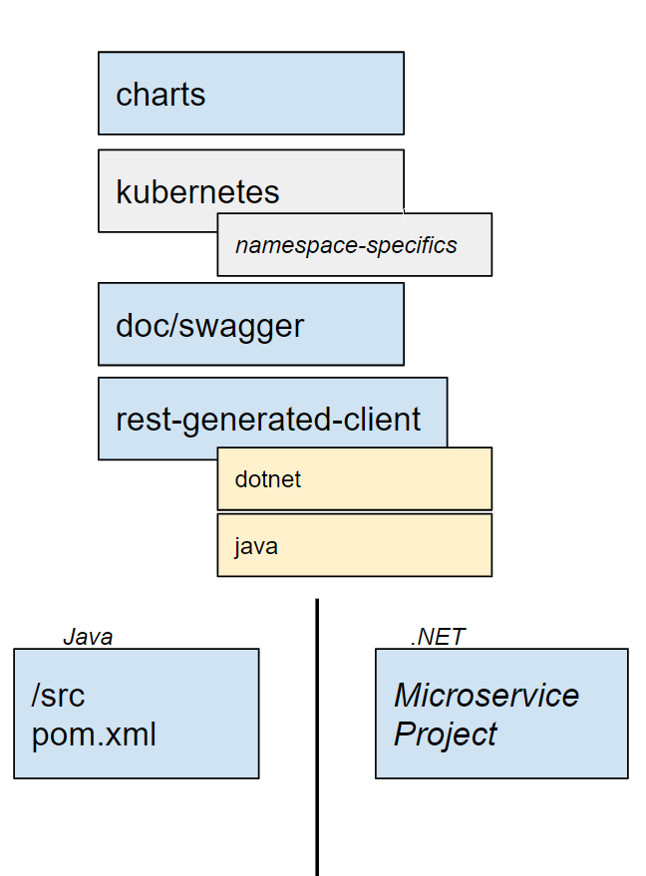
Makeup of a Microservice
Helm Chart (and or/ Yaml files)
Service itself
Swagger docs (used for documentation and auto-gen)
Rest-generated-client (used for auto-gen specifics)
Pipeline file
br1
br2
common
compile
Package (docker)
Deploy env
Deploy env

Slide 24
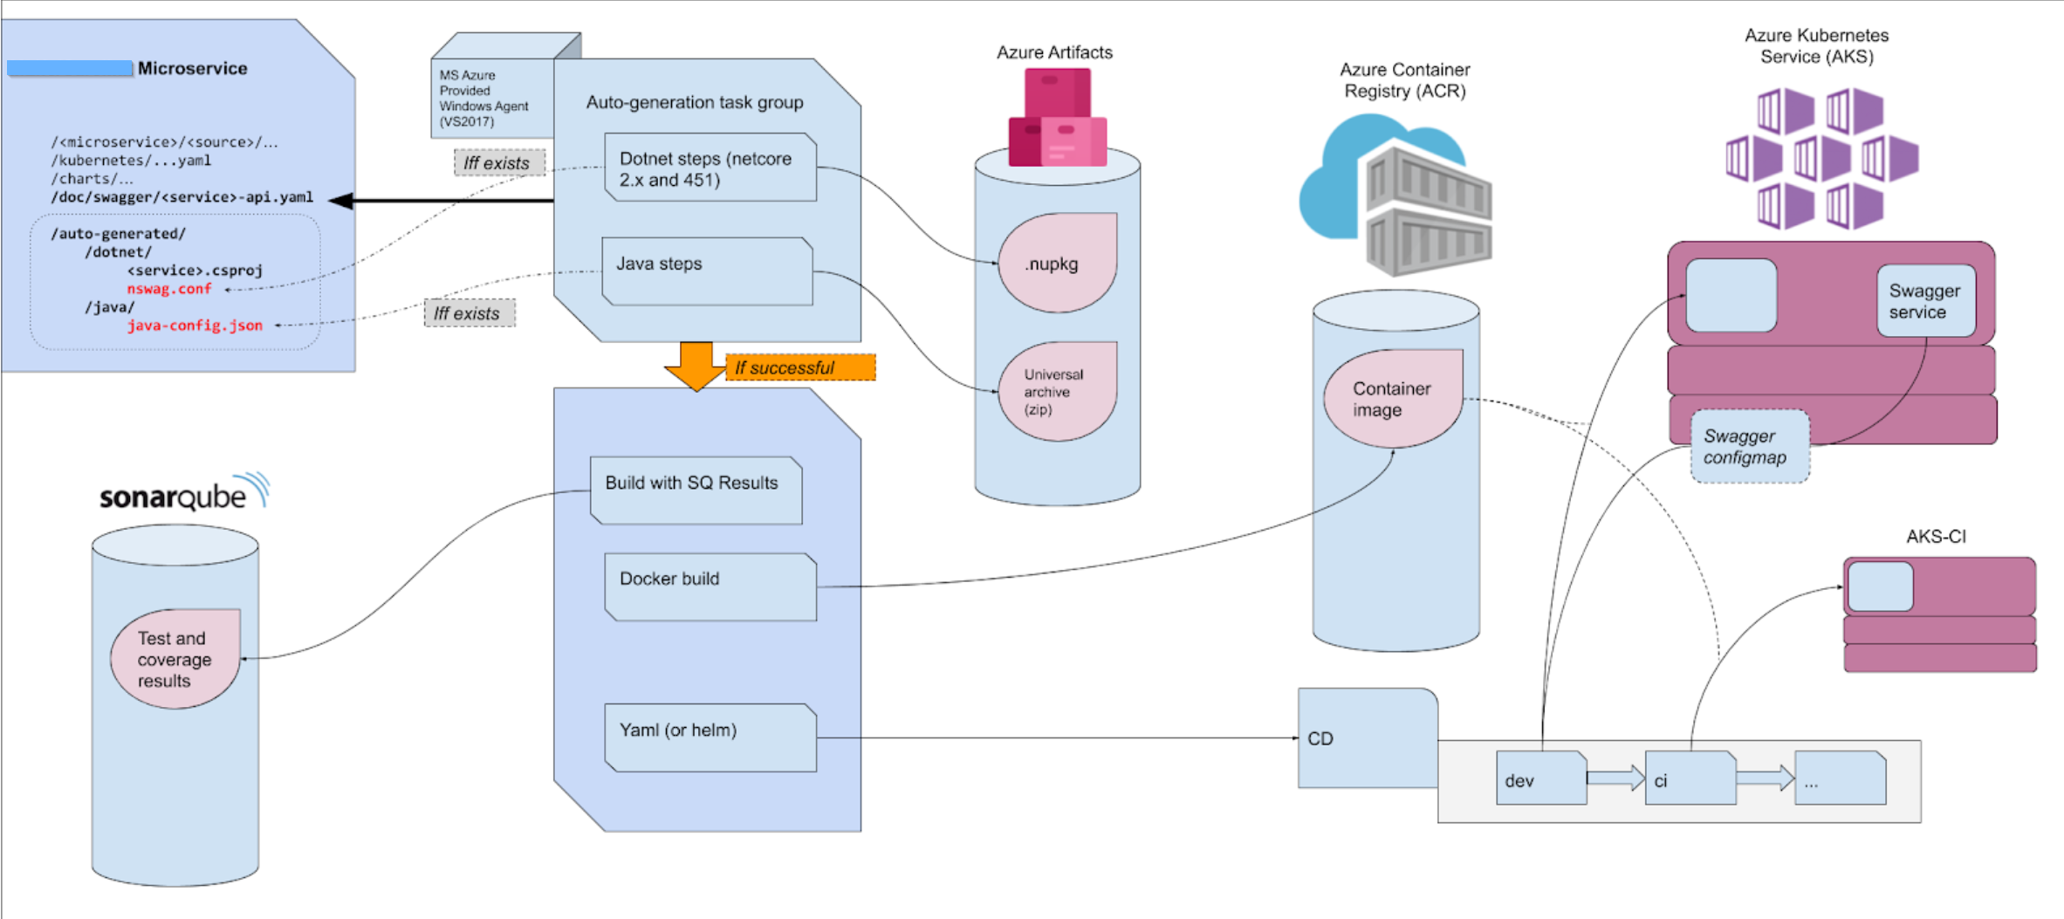
Full Process : Overview

Slide 25
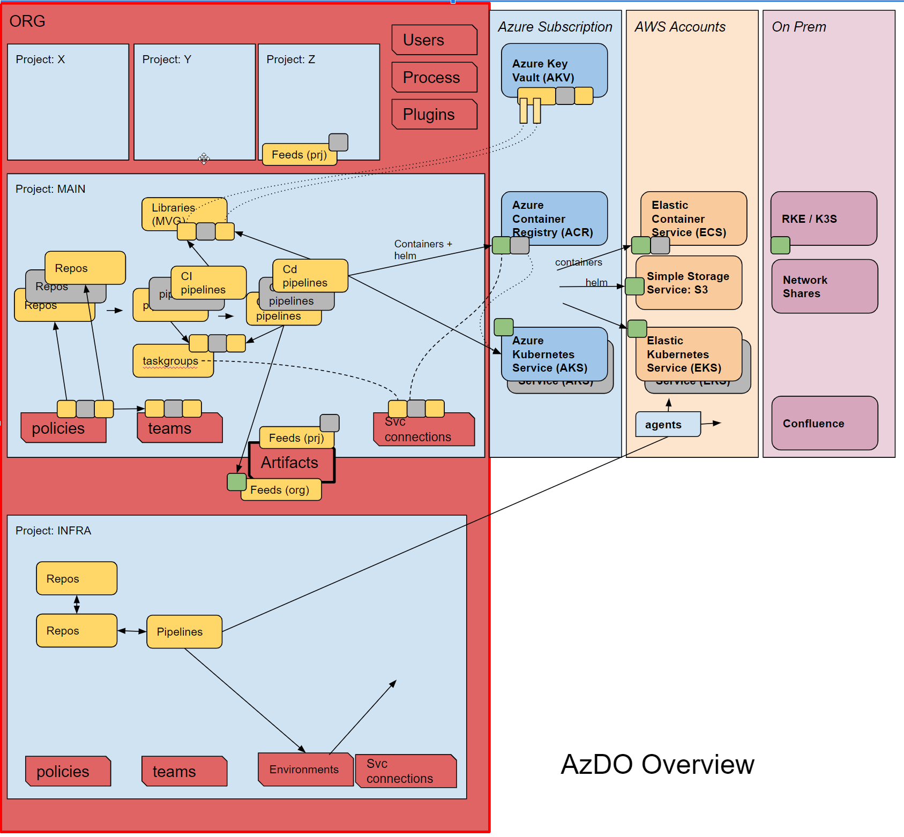
Multi-Cloud
Following patterns allowed us to scale
Charts/Containers/Helm (green) are the same over multiple environments
INFRA team creating agents in restricted environments (sharing them to MAIN)

Slide 26
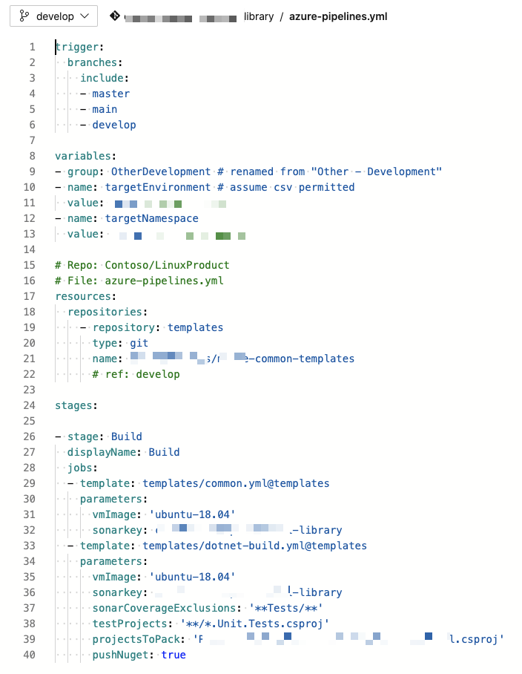
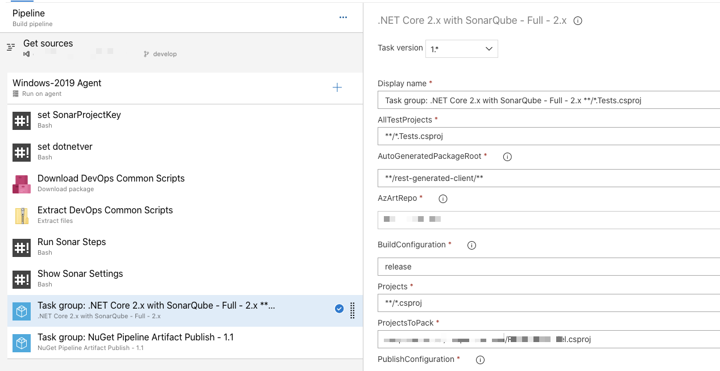
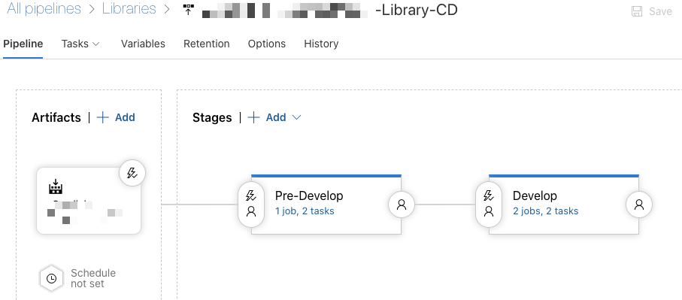
Key differences
Classic UI
Still used with Test Plans
Easy Graphic Interface
Managed by “Build Team”
Control at Release Pipelines/Gates
YAML Templates
All modern CICD use YAML
Empowers Developers to own pipelines and contribute to common Templates
Control at Environments
Notes:
https://docs.microsoft.com/en-us/azure/devops/pipelines/process/templates?view=azure-devops

Slide 27
Considerations
How do my developers learn about Azure DevOps?
How do we inform but also enforce Patterns?
What is our cost model? Do we charge back? Can we leverage VSE?
Where is our compute? Where do we deploy?
How do we manage identities?
Empowering Developers with YAML requires trust
Requiring managed agents creates choke points
VMSS and Azure Pipelines scale
Library (AKV / Group Variables) can create unnecessary abstraction
Directly access with AKV
Minimize blast radius by more narrowly focused Vaults
Library requires manual selection/mapping
Minimize use of “Build Variables” settable at build time
Don’t try to make AzDO into a utility Jenkins job
Notes:
Consider the impact of Sidecars on Cron Jobs
The non-persistent cron may close, but the sidecar remains
https://docs.microsoft.com/en-us/azure/active-directory/develop/active-directory-configurable-token-lifetimes

Slide 28
Growth Areas
Can I rely on a single cloud PaaS?
What are my migration considerations if the offering becomes no longer viable?
What are my methods of control and auditing?
What if we succeed? How does Day 2 look? How do we scale? What do those costs look like?
Infrastructure
The right way to expose secrets to Pods
Service Mesh Options (Istio, Consul, etc)
Ingress (Istio, Nginx, Ambassador, etc)
Secrets Providers (Hashi Vault, or AKV)
Csi-secrets-store-provider-azure for AKS with managed identity
Promotions
Proper way to promote releases
Especially interdependent or loosely coupled to a data layer
Proper way to validate and test
Notes:
https://docs.microsoft.com/en-us/azure/key-vault/general/key-vault-integrate-kubernetes

Slide 29
Thank you / Questions
Slides:
https://bit.ly/2NnEeZT
https://freshbrewed.science/OSN2021/OSN_+Full+Stack+CICD+of+Kubernetes+Microservices+using+DevOps+and+IaC.pdf
https://freshbrewed.science/OSN2021/OSN_+Full+Stack+CICD+of+Kubernetes+Microservices+using+DevOps+and+IaC.pptx
Blog: https://freshbrewed.science

